Slide 1
Stack Overflow Developer Survey
TECHNOLOGY TREND ANALYSIS
Prepared by Boris Nikolovski
4/23/2023
IBM Data Analyst Professional Certificate - IBM Data Analyst Capstone Project - Final Presentation

Slide 2
EXECUTIVE SUMMARY
The annual surveys, conducted regularly by online programming knowledge sharing platform Stack Overflow, aim to collect data on technology usage and trends among developers.
This presentation refers to analyzes obtained from a subset of databases obtained from surveys conducted in 2019 in which a total of 85,987 respondents were registered. The analyzes were performed using two datasets:
Data Technologies Survey for Developers with 74,589 Respondents
A survey on the demographic structure of developers with the participation of 11,398 respondents
The presentation provides an analysis of the current situation in the field of users of software technologies, their aspirations for the coming year as well as their demographic structure.
These findings are particularly relevant to current and aspiring interested in using software technologies
Audience: Developers, HR professionals, Educators, Policy Makers, IT Industry Leaders, Students. Current, Aspirants, Professionals, Hobbyists.

Slide 3
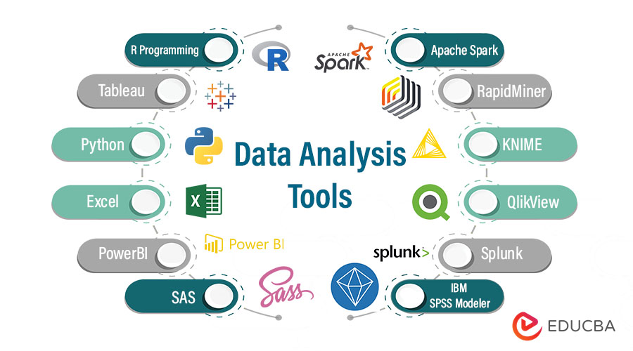
TABLE OF CONTENTS
Introduction
Objectives
Methodology
Results
Data
Visualizations
Findings & Implications
Dashboards
Overal Findings and Implications
Conclusion
Appendix
References

Slide 4
INTRODUCTION
This presentation report uses data analytics to highlight current and projected trends in the need for skills related to programming languages, databases, platforms and web frames, as well as the demographic structure of the respondents.
The following inquiries were investigated using the data:
Technology trends present and future.
Programming Languages
Database
Program Platforms
Web Frameworks
Demographic classification
By Gender
By Country
By Age
By Education
The target audience for this research are IT professionals, HR managers, and anybody else with an interest in the IT sector who wants to learn about the top on-demand IT skills in their respective sectors that will also still be relevant in the future.

Slide 5
OBJECTIVES The main objectives of this presentation
Obtaining knowledge about the situations in the world of users of software technologies.
Using analytical technology to gain insight into technology trends used in software worldwide; predict technology trends that will be used in software around the world in the future; gain insight into the demographic structure of software technology users around the world.
The knowledge obtained to serve for making decisions related to using software technologies.

Slide 6
OBJECTIVES The key questions answered by this presentation
Current Technology Usage
Displays Top 10 Languages Worked With according to the survey
Displays Top 10 Database Worked With according to the survey
Displays Platform Worked With according to survey
Displays Top 10 Web Frame Worked With according to survey
Future Technology Trend
Displays Top 10 Language Desires Next Year according to the survey
Displays Top 10 Database Desire Next Year according to the survey
Displays Platform Desire Next Year according to survey
Displays Top 10 Web Frame Desire Next Year according to the survey
Demographic
Displays the Respondent classified by Gender according to the survey
Displays Respondent Count for Countries by survey
Displays Platform Desire Next Year according to survey
Displays the Top 10 Web Frame Desire Next Year according to the survey

Slide 7
METHODOLOGY
Dataset Collections: download dataset in CSV format from Stack Overflow Developer Survey
Demographic survey : m5_survey_data_demographics.csv
Technologies survey: m5_survey_data_technologies_normalised.csv
Data Wrangling (Munging):
Cleaning, transforming, and enriching raw data into a more usable format for analysis. Using various SQL and Python techniques with appropriate required libraries, mainly Pandas, removing duplicates, correcting errors, handling missing data, transforming data into a consistent format, were performed.
Data Visualization:
By using Pandas procedures, filtered data is obtained to show the results according to the set goals.
The filtered data, according to the set goals, were transferred to the IBM Cognos Analytics platform, with appropriate graphic charts to visualize the results.
Presentation:
The presentation is prepared in PowerPoint with the desire to capture the results of the survey in a clear and simple way in order to be useful for those interested in the field of using software techniques.

Slide 8
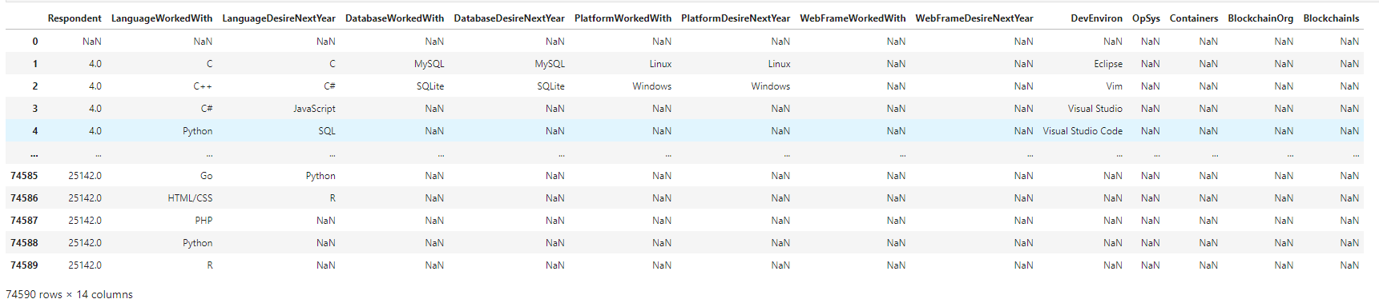
RESULTS Technology trends
Overall data: in total 13 questions and 74,590 responders

Slide 9
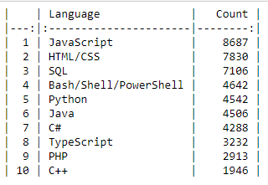
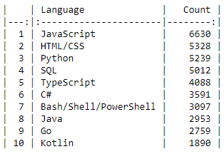
RESULTS Technology trends PROGRAMING LANGUAGES
PROGRAMING LANGUAGES TREND – PRESENTED DATA COMPARATIVELY
Programing Languages that are used the most
Programing Languages most desired for next year

Slide 10
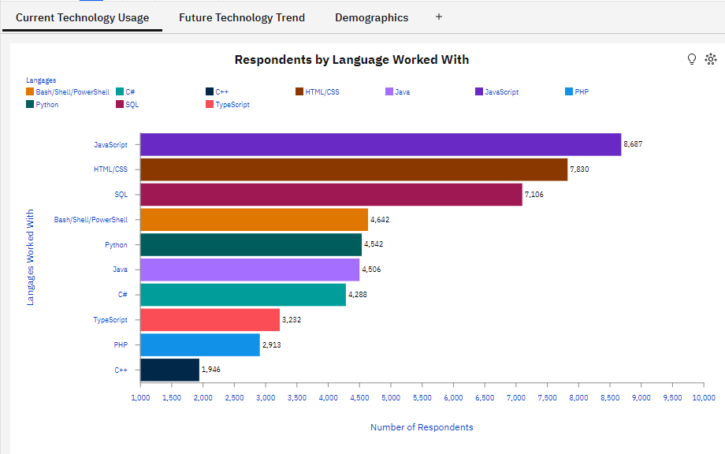
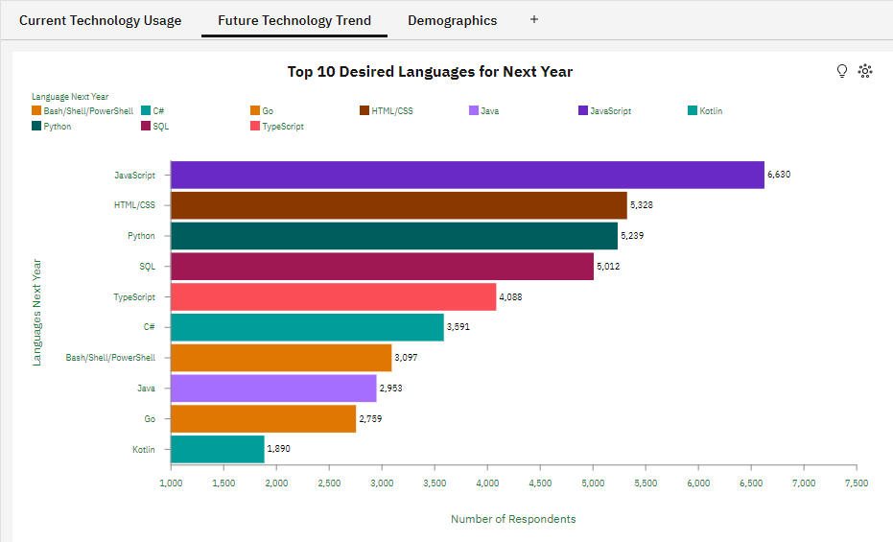
RESULTS Technology trends PROGRAMING LANGUAGES
PROGRAMING LANGUAGES TREND – GRAPH
Programing Languages that are used the most
Programing Languages most desired for next year

Slide 11
RESULTS Technology trends PROGRAMING LANGUAGES
Findings:
The leading role in the use of programming languages of JavaScript and HTML/CSS indicates that most of the respondents are oriented towards WEB applications and this will continue in the next year.
SQL is and will remain the leader for managing large databases for a long time.
The growing interest in Python continuously indicates that a growing number of respondents are also oriented towards high-level, interpreted programming language that is widely used for general-purpose programming.
‘C Sharp’(C#), as a modern object-oriented programming language, holds firm with high interest among the respondents, even records increased interest for the coming year.
Implications:
The results of this analysis unequivocally imply that the largest number of respondents are oriented towards web design.
The rapid advancement of AI technology increases respondents' interest in Python with its vast number of libraries.
Interest in database management remains high among respondents and is the third largest interest group in software technology.

Slide 12
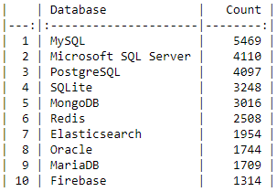
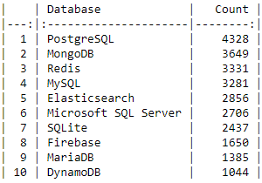
RESULTS Technology trends DATABASE
DATABASE TREND – PRESENTED DATA COMPARATIVELY
Database that are used the most
Database most desired for next year

Slide 13
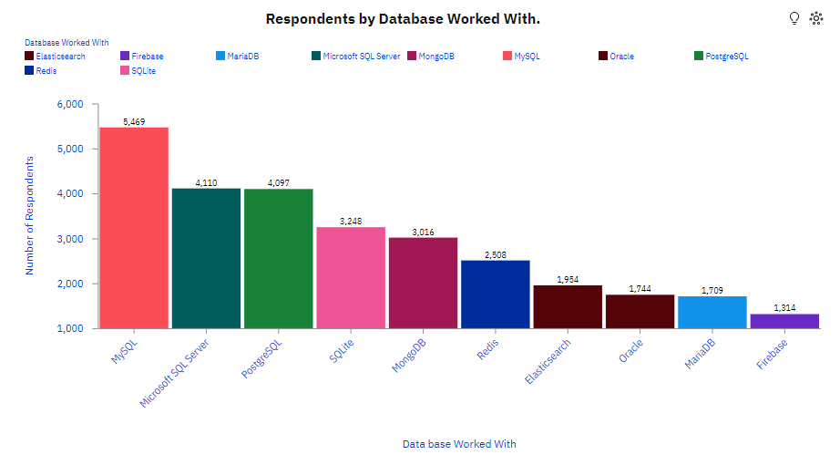
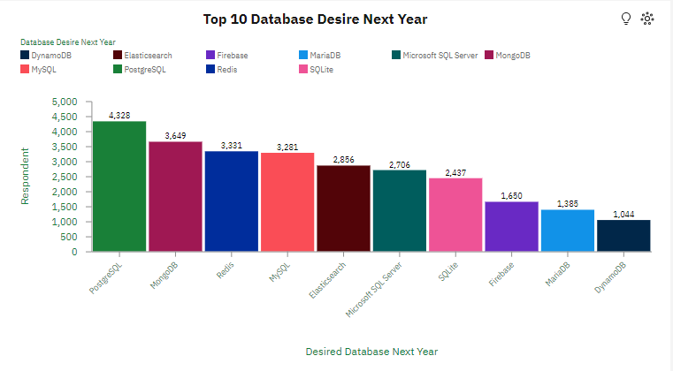
RESULTS Technology trends DATABASE
DATABASE TREND – GRAPH
Database that are used the most
Database most desired for next year

Slide 14
RESULTS Technology trends DATABASE
Findings:
Currently, the most used database management language is MySQL, by a significant margin over the others. But the interest in its use in the coming year is significantly decreasing.
Microsoft SQL Server and PostgreSQL are tied in developer usage behind MySQL among respondents. Unlike Microsoft SQL Server, for which interest is significantly decreasing, PostgreSQL is becoming the most desired database language for the coming year.
The presence of Firebase among the ten most used databases is noticeable, and the interest in its use is increasing even more in the coming year.
The most used NoSQL databases are MongoDB and Redis.
Implications:
PostgreSQL's features as a relational database management system known for its robustness, reliability, and scalability make it the мост preferred database of the coming year.
The increased interest and usability of a document-oriented database program that uses JSON-like documents with optional schemas also implies increased interest in MongoDB, which becomes the second most preferred database for the coming year among respondents.

Slide 15
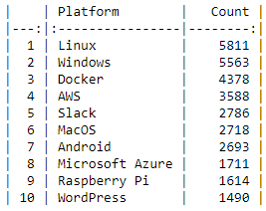
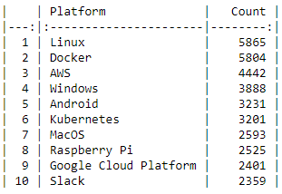
RESULTS Technology trends PLATFORMS
PROGRAM PLATFORMS– PRESENTED DATA COMPARATIVELY
Platforms that are used the most
Platforms most desired for next year

Slide 16
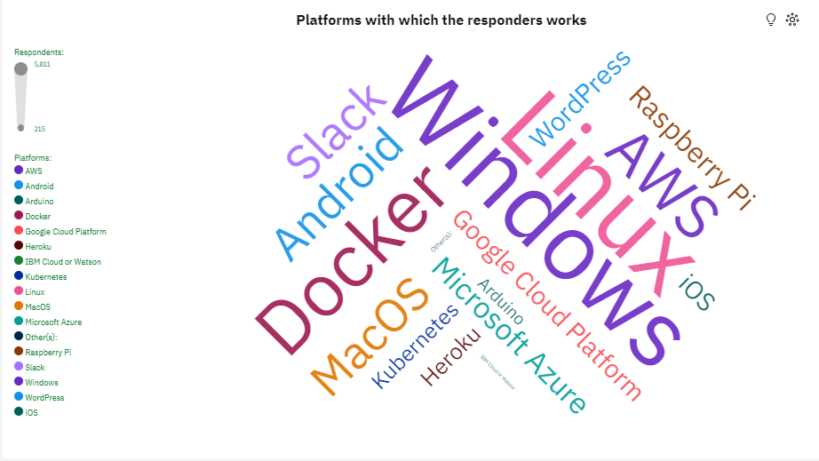
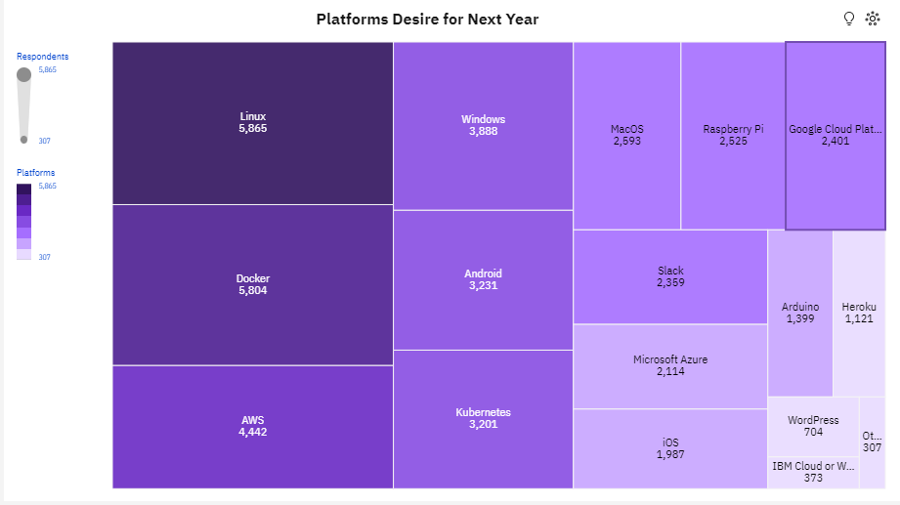
RESULTS Technology trends PLATFORMS
PROGRAM PLATFORMS – PRESENTED VISUALLY COMPARATIVELY
Platforms that are used the most
Platforms most desired for next year

Slide 17
RESULTS Technology trends PLATFORMS
Findings:
Operating system platforms are understandably the most used, led by Linux and Windows. For the next year, interest in Windows is decreasing, but interest in containerization platform through Docker and Amazon Web Services (AWS) as Cloud computing platform is increasing.
The significant use of Slack as a Collaboration platform is notable, but the interest decreases in the coming year, when the interest in Google Cloud Platform (GCP) and Kubernetes increases sharply.
The interest among the respondents is slightly decreasing for using MacOS in the coming year, but the interest in Android as a Mobile application platform is increasing.
Implications:
Despite the fact that the interest in using Operating system platforms for the next year is significantly decreasing, still the largest part of respondents will work on these platforms.
The containerization platform among respondents will remain in the coming year as the second most used platform, but with a dramatically increased interest. This is especially so as Docker ranks second in terms of interest and Kubernetes appears in the top 10 most preferred platforms.

Slide 18
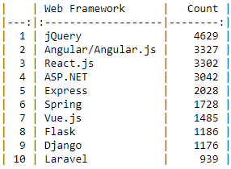
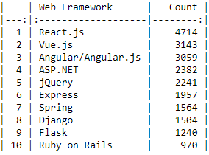
RESULTS Technology trends WEB FRAMEWORK
WEB FRAMEWORKS– PRESENTED DATA COMPARATIVELY
Web Frameworks that are used the most
Web Frameworks most desired for next year

Slide 19
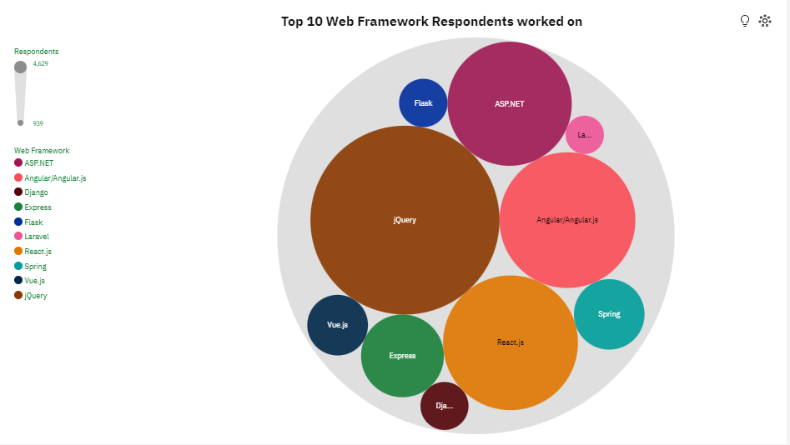
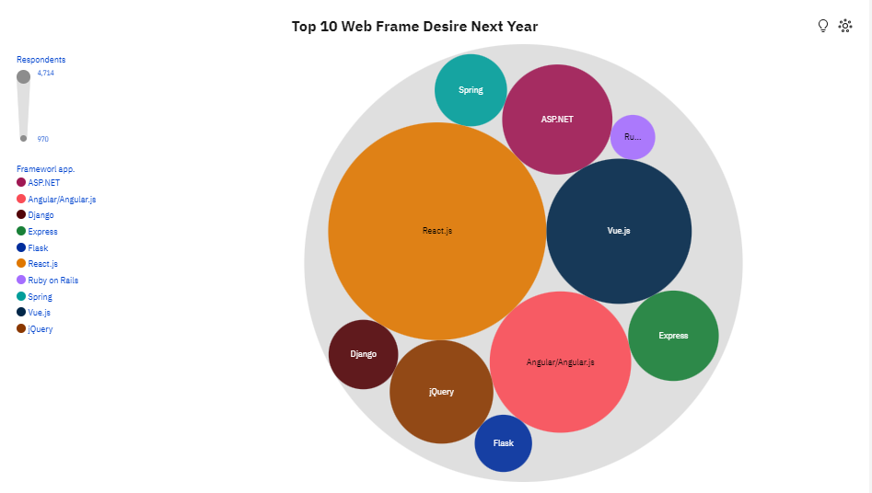
RESULTS Technology trends WEB FRAMEWORK
WEB FRAMEWORKS – PRESENTED VISUALLY COMPARATIVELY
Web Frameworks that are used the most
Web Frameworks most desired for next year

Slide 20
RESULTS Technology trends WEB FRAMEWORK
Findings:
Popular JavaScript libraries and frameworks are leading in number of users among respondents. For the next year, the interest in jQuery is halved, while React.js becomes the most attractive.
Interest in Vuе.js is increasing almost threefold for the coming year, making it the second most preferred web platform.
Interest in ASP.NET as a Microsoft .NET platform does not change in the following year, remaining in fourth position with a slightly reduced number of interested respondents.
Flask and Django, as a web framework for Python, also slightly change their positions in the following year, but with a noticeable percentage increase in the number of interested respondents.
Implications:
Open source JavaScript libraries and frameworks are by far the most used and preferred, led by React.js and Angular. When Express and Vue.js are added as an open source web application framework for Node.js, which is a JavaScript runtime environment, it reaffirms that the most preferred programming language is JavaScript.
The survey indicates that the usage, but the interest in usage and further with the intention to increase, is registered in web frameworks for Python, especially through Django and Flask

Slide 21
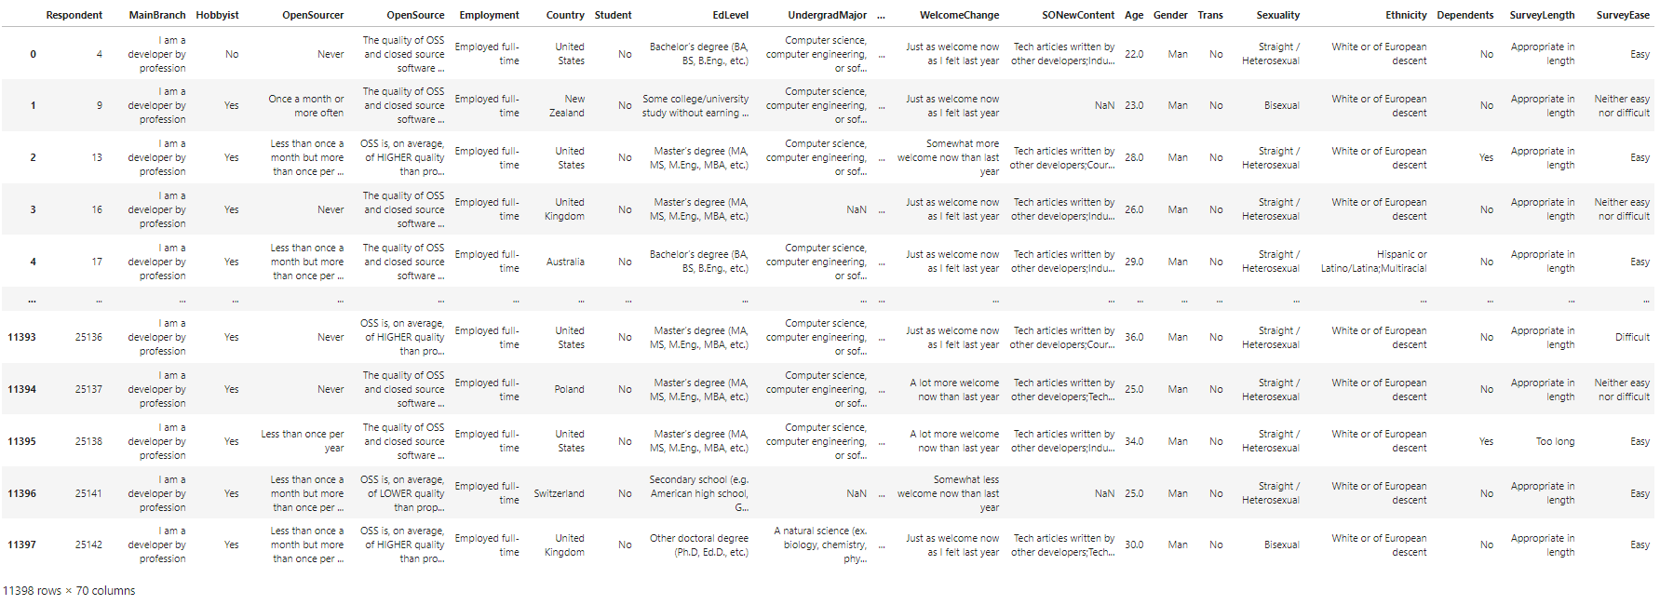
RESULTS DEMOGRAPHIC
Overall data: in total 14 questions and 11,397 block of answers

Slide 22
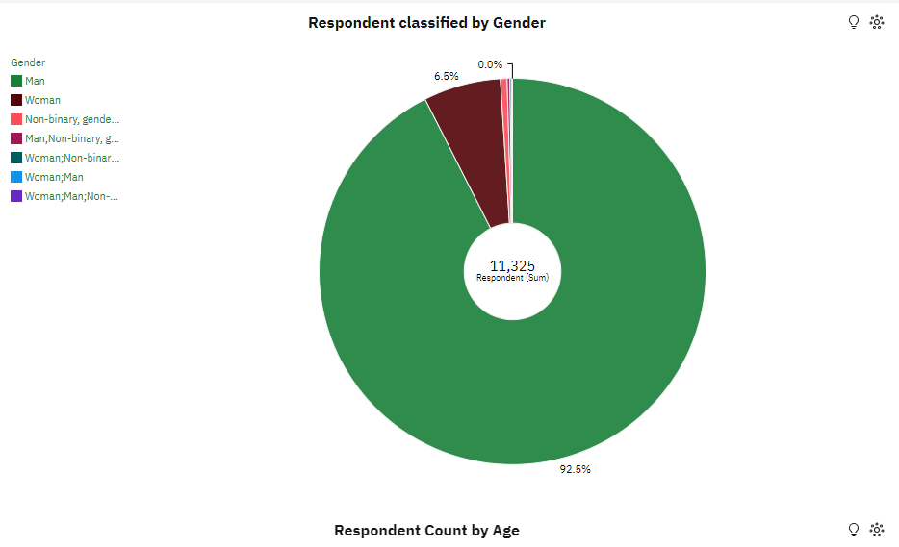
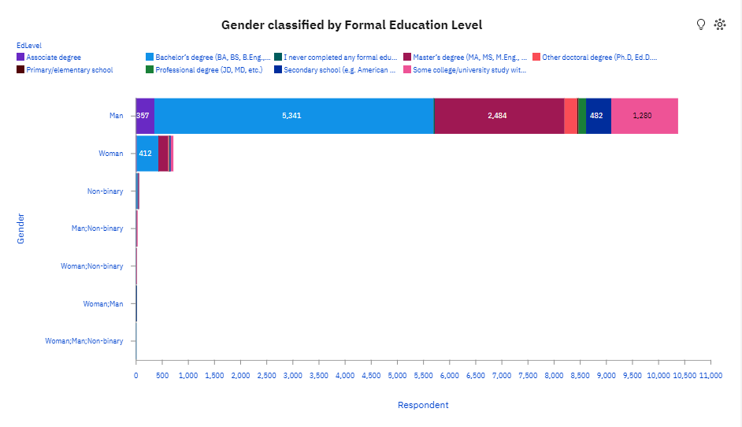
RESULTS DEMOGRAPHIC
GENDER CLASSIFIED BY RESPONDENTS AND EDUCATION – PRESENTED VISUALLY
Respondents classified by Gender
Gender classified by Formal Education

Slide 23
RESULTS DEMOGRAPHIC
GENDER CLASSIFIED BY RESPONDENTS AND EDUCATION – Finding & Implications
Findings:
A surprisingly large majority of respondents identified as ‘Man’ (92.5%) compared to a very small percentage (6.5%) who identified as ‘Woman’ in terms of their gender.
An insignificantly small percentage (< 1%) who declared themselves with other classification of Gender were also registered.
More than half of respondents by Gender 'Men' have a Bachelor's degree. The ratio of formal education among 'Women' is on the same level as 'Men‘.
Implications:
The disproportionate ratio of respondents in terms of gender is disappointing due to the very low response to the survey by responders who identified as ‘Woman’!
The high degree of formal education is understandable because of the problems faced in working with software technologies.

Slide 24
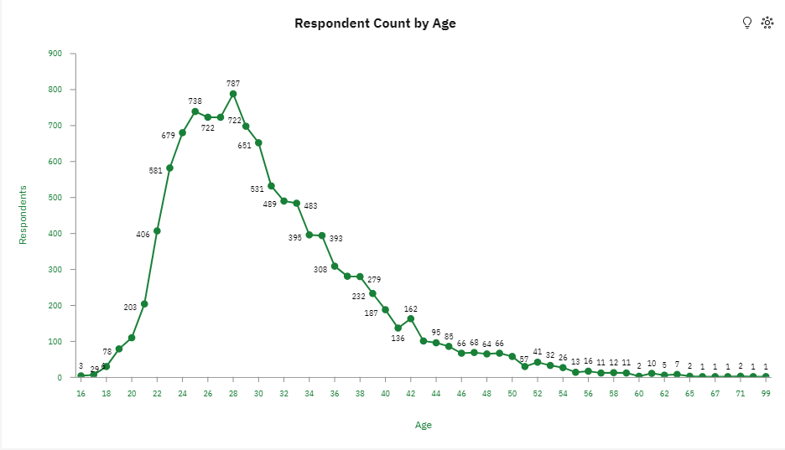
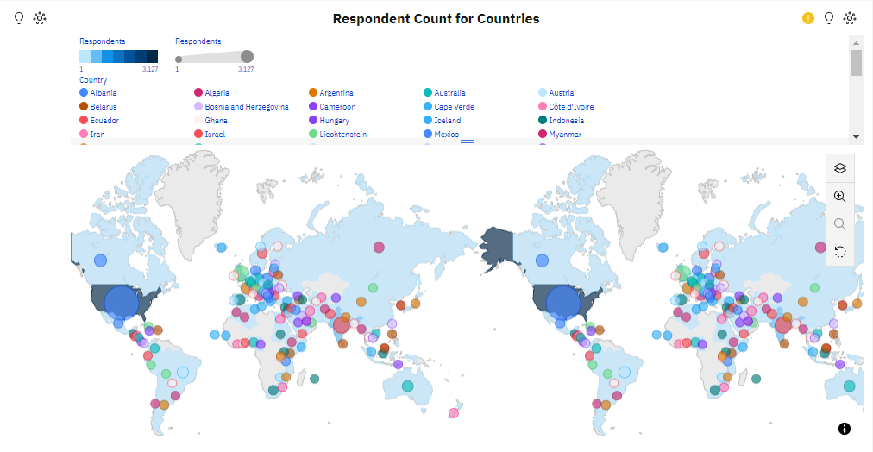
RESULTS DEMOGRAPHIC
RESPONDENTS CLASSIFIED BY AGE AND COUNTRY – PRESENTED VISUALLY
Respondents classified by Age
Gender classified by Country

Slide 25
RESULTS DEMOGRAPHIC
RESPONDENTS CLASSIFIED BY AGE AND COUNTRY – Finding & Implications
Findings:
Of the respondents, according to their age, the most represented are between the ages of 24 and 30, and the 28-year-olds are the most represented.
Respondents from 135 countries were included in the survey. Most of them are from the US, with a number almost four times greater than the second ranked India. This is followed by the United Kingdom, Germany, Canada, etc.
Implications:
At the age of under 20 and over 40, the response to the survey is extremely small, which is rather disappointing, because in those age categories there are significant intellectual capacities! The only respondent at the age of 99 and the three at the age of 16 should serve as a positive example and encouragement!
The large number of countries from which respondents have registered is to be welcomed, but unfortunately the response from many countries is small, especially from China, where only 69 respondents have registered despite the large population and the technological breakthrough in informatics!

Slide 26
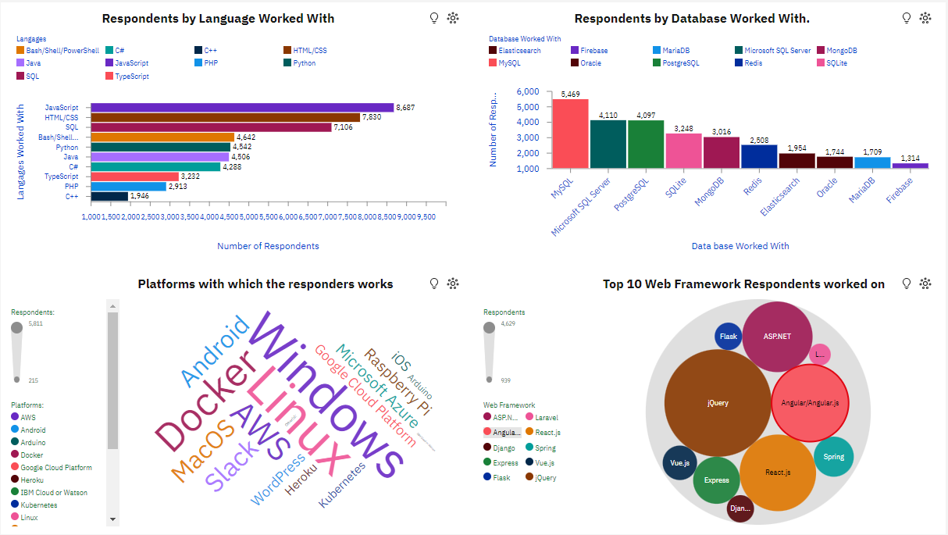
DASHBOARD CURRENT TECHNOLOGY USE Dashboard Tab 1
Link: https://us1.ca.analytics.ibm.com/bi/?perspective=dashboard&pathRef=.my_folders%2FCapstone%2BProject%2B-%2BFinal%2BPresentation&action=view&mode=dashboard&subView=model00000187ab0d1feb_00000000

Slide 27
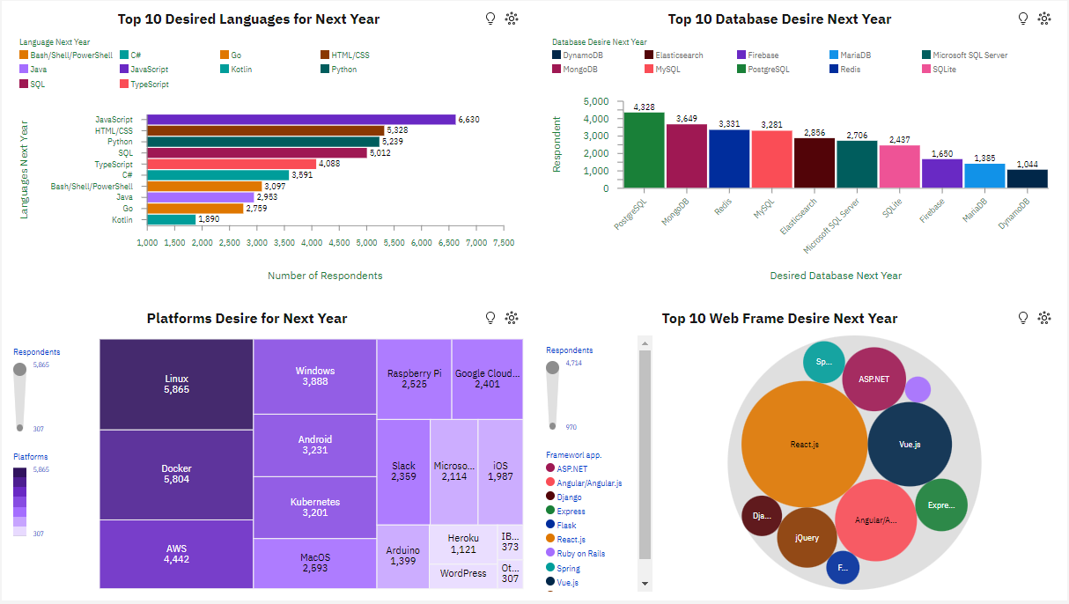
DASHBOARD FUTURE TECHNOLOGY TREND Dashboard Tab 2
Link: https://us1.ca.analytics.ibm.com/bi/?perspective=dashboard&pathRef=.my_folders%2FCapstone%2BProject%2B-%2BFinal%2BPresentation&action=view&mode=dashboard&subView=model00000187ab0d1feb_00000000

Slide 28
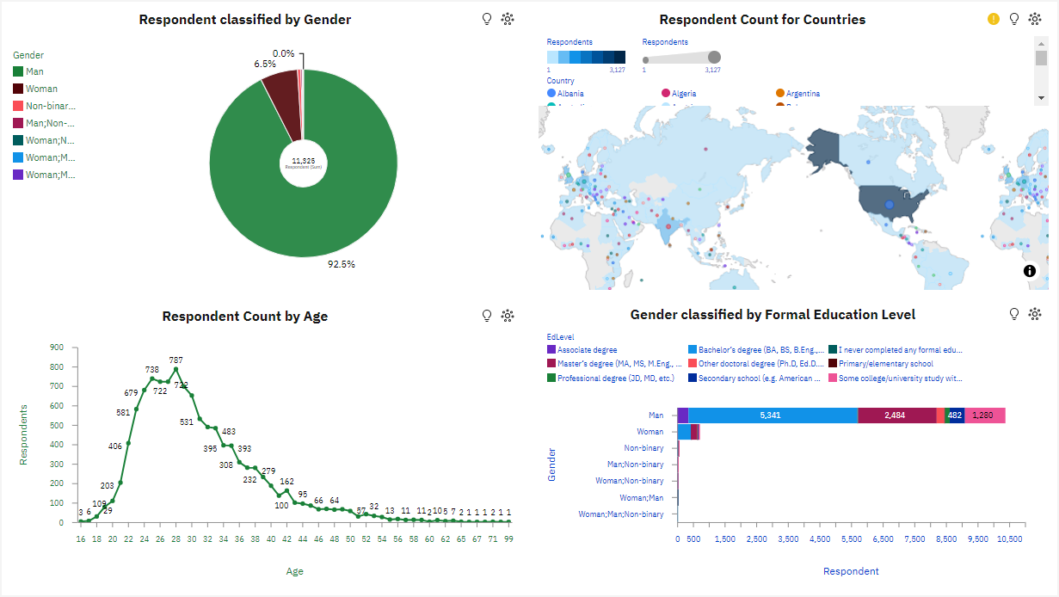
DASHBOARD DEMOGRAPHIC Dashboard Tab 3
Link: https://us1.ca.analytics.ibm.com/bi/?perspective=dashboard&pathRef=.my_folders%2FCapstone%2BProject%2B-%2BFinal%2BPresentation&action=view&mode=dashboard&subView=model00000187ab0d1feb_00000000

Slide 29
OVERALL Findings Implications
Java Script, HTML/CSS and in the future retains the leading interest among users of software technologies.
A significantly increased interest is being shown for Python in the future.
With Databases, the situation is more dynamic. PostgreSQL, MongoDB and Redis are much more attractive for the future than MySQL and Microsoft SQL Server.
In the field of Web Frameworks, JQuery fatigue is evident, as is the growing interest in React.js, and especially Vue.js
The result obtained from the demographic structure of the respondents in terms of gender is striking. Even 92.5% declared that they were men, and only 6.5% of respondents in the field of software technologies are women.
Most of the respondents are oriented towards WEB software technologies, and they will maintain the same interest in the future.
The analysis indicates a growing interest in interpreted programming languages.
Interest in open source software for databases is also growing significantly.
With such a small percentage of respondents who declare themselves as Women, the real picture is distorted in all segments of the population that deals with software technologies.

Slide 30
CONCLUSION OVERAL
Developers who work on some functional programming languages, such as Clojure and F#, are the best paid in the field of software technologies. On the other hand, those who work in a web environment, as well as with a general-purpose interpreted programming language like Python, are rather less paid, but are still the most desired! I guess the answer lies in the following:
All the most desirable ones are open-source, and this brings with it huge advantages in their development. A huge community of developers who contribute to a wide range of open-source libraries, frameworks, help, support, ideas etc.
They are attractive, creative and dynamic in nature.
They are relatively easy to learn.
The versatility of Python's usability is dynamically making it an increasingly sought-after and paid-for programming language.
The general technological development and the needs of innovation are a generator for changes and advancement in software technologies.
Software technologies need to expand their boundaries by eliminating age, gender and racial discrimination, as well as by including a growing number of countries of the world in the programming community.

Slide 31
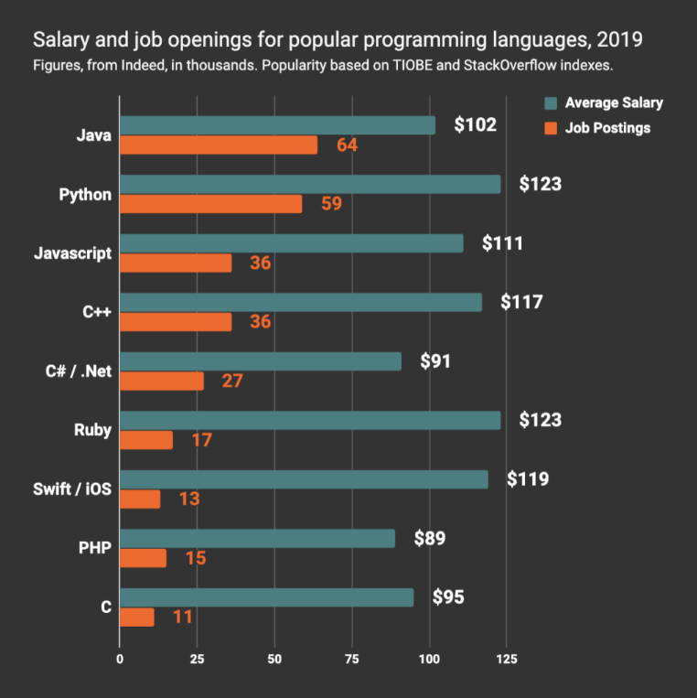
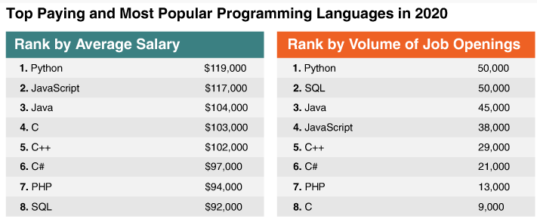
APPENDIX POPULAR PROGRAMING LANGAGES Salary/Job Openings
Python remains the most incentivized in terms of salary and need for programmers among popular programming languages in the coming year.
There is an equal need for developers in SQL, although they are less incentivized with a salary than Python for the next year.

Slide 32
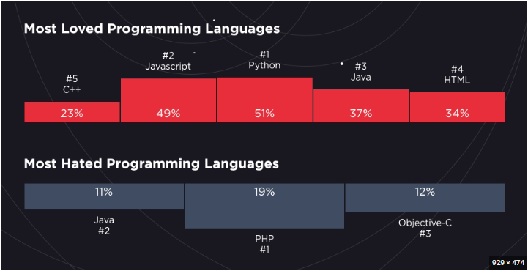
APPENDIX PROGRAMING LANGAGES Popularity
Hired's 2019 Survey of Software Engineers presented new insights into the state of programming languages. 98,000 programmers participated in the survey to vote on, among other things, the most loved and hated programming languages, and the results are quite surprising. Java appear on both lists for the most loved and most hated programming language! The survey were conducted separately for both questions. The reason for the dislike was that it is not fun to code in Java. The biggest reason to love Java is the availability of resources for learning and developing software along with community tone and willingness to welcome newcomers.

Slide 33
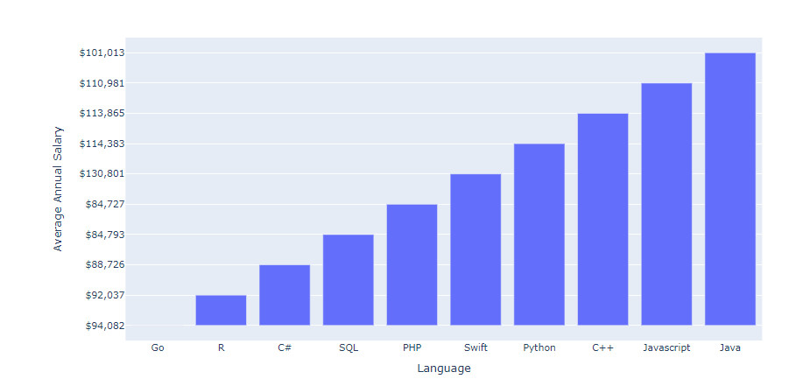
APPENDIX Programing Languages Salary
Programming_Languages.html

Slide 34
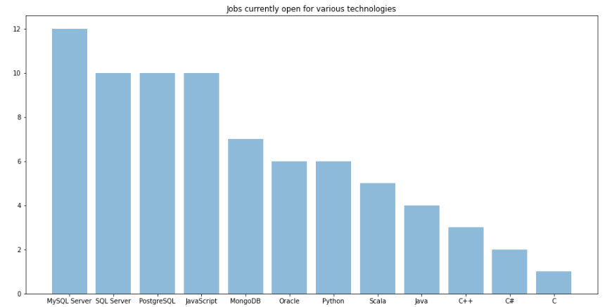
APPENDIX Programing Languages Jobs
GitHub Jobs data

Slide 35
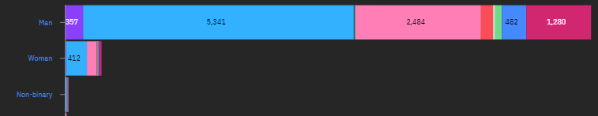

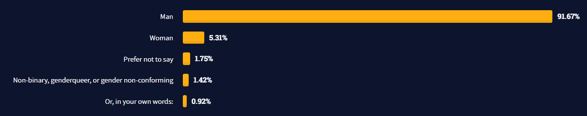
APPENDIX DEMOGRAPHIC Gender
Stack Overflow Survey 2019
Stack Overflow Survey 2020
Stack Overflow Survey 2021

Slide 36
REFERENCES
Github/IBM-Capstone-Project: https://github.com/Borache55/IBM-Capstone-Project
All data in the appendix is based on research by Stack Overflow
Capston Project link to Dashboard:
https://us1.ca.analytics.ibm.com/bi/?perspective=dashboard&pathRef=.my_folders%2FCapstone%2BProject%2B-%2BFinal%2BPresentation&action=view&mode=dashboard&subView=model00000187ab0d1feb_00000000
Stack Overflow Survays: https://insights.stackoverflow.com/survey
Slide 29-1/CodePlatoon: https://www.codeplatoon.org/the-best-paying-and-most-in-demand-programming-languages-in-2019/
Slide 29-2/CodePlatoon: https://www.codeplatoon.org/best-paying-most-in-demand-programming-languages-2020/
Slide 30-1/Fossbytes: https://fossbytes.com/most-loved-hated-programming-languages-2019/
Slide 30-2/Html Hints: https://www.htmlhints.com/article/top-10-highest-paid-programming-languages-in-2020/117
Slide 32-1/freeCodeCamp: https://www.freecodecamp.org/news/stack-overflow-developer-survey-2020-programming-language-framework-salary-data/
Slide 32-2/Stack Overflow: https://insights.stackoverflow.com/survey/2021#developer-profile-demographics

